Slide 1

HATE SPEECH DETECTION
Guide Name: MRS. ABHA KAUSHIK
Team Member(s):
SWAPNIL TIWARI (2001920100301)
SWAPNIL VERMA (2001920100302)
SUDHIR YADAV (2001920100297)
SATYAM GUPTA (2001920100262)

Slide 2
Table of Content
Introduction
Study of existing work
Problem Definition
Objective(s)
Proposed Methodology
Conclusion and Future Scope
References (APA Format)

Slide 3
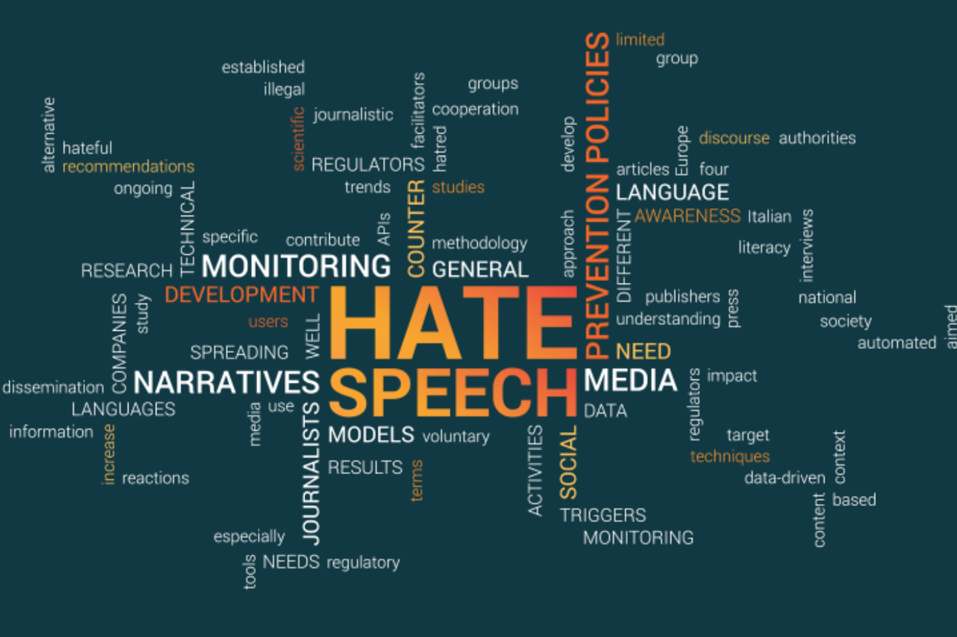
Introduction
Hate speech detection using machine learning is an important and timely topic in today's world where the prevalence of hate speech and online harassment is on the rise. Hate speech refers to any language or behaviour that expresses prejudice or discrimination against a particular group of people based on their race, ethnicity, gender, religion, sexual orientation, or other personal characteristics. Hate speech can be damaging to individuals, groups, and society, and it is, therefore, important to develop tools and methods to detect and mitigate its impact.
Machine learning is a powerful tool for hate speech detection because it can analyze large amounts of data and learn patterns and features that can be used to classify text as either hate speech or not. Machine learning algorithms can be trained on annotated datasets of hate speech to identify key features and patterns.

Slide 4
Problem Definition
Hate speech is a pressing issue in online spaces, necessitating effective detection systems. The core challenges include data collection, multilingual and multimodal detection, context understanding, minimizing false positives and negatives, defense against adversarial attacks, addressing bias and fairness, scalability, and privacy concerns. The goal is to create accurate, fair, and scalable systems that identify and mitigate hate speech for a safer online environment.

Slide 5

Problem Definition
The problem is to develop AI systems that can effectively and accurately identify hate speech in online content. This involves challenges such as data collection, multilingual detection, context understanding, reducing false positives/negatives, defending against adversarial attacks, addressing bias and fairness, scalability, and privacy concerns. The objective is to create robust, fair, and scalable hate speech detection solutions to promote a safer online environment.

Slide 6
Study of existing work
Existing work in hate speech detection encompasses various aspects, including text-based models, multimodal approaches, contextual analysis, transfer learning, fairness and bias mitigation, adversarial defense, evaluation metrics, privacy considerations, and deployment in real-time. Researchers and practitioners are actively addressing these challenges to improve the accuracy, robustness, and ethical considerations in hate speech detection systems.

Slide 7
Objective
The primary objectives of our project are to:
Data Collection and Labeling: Gather diverse text data and label it as hate speech or non-hate speech.
Model Training: Train a machine learning model to recognize patterns in the labeled data.
Evaluation and Validation: Assess the model's performance using metrics and ensure it generalizes well.
Deployment and Improvement: Implement the model in real applications and continuously refine it to detect evolving hate speech.

Slide 8
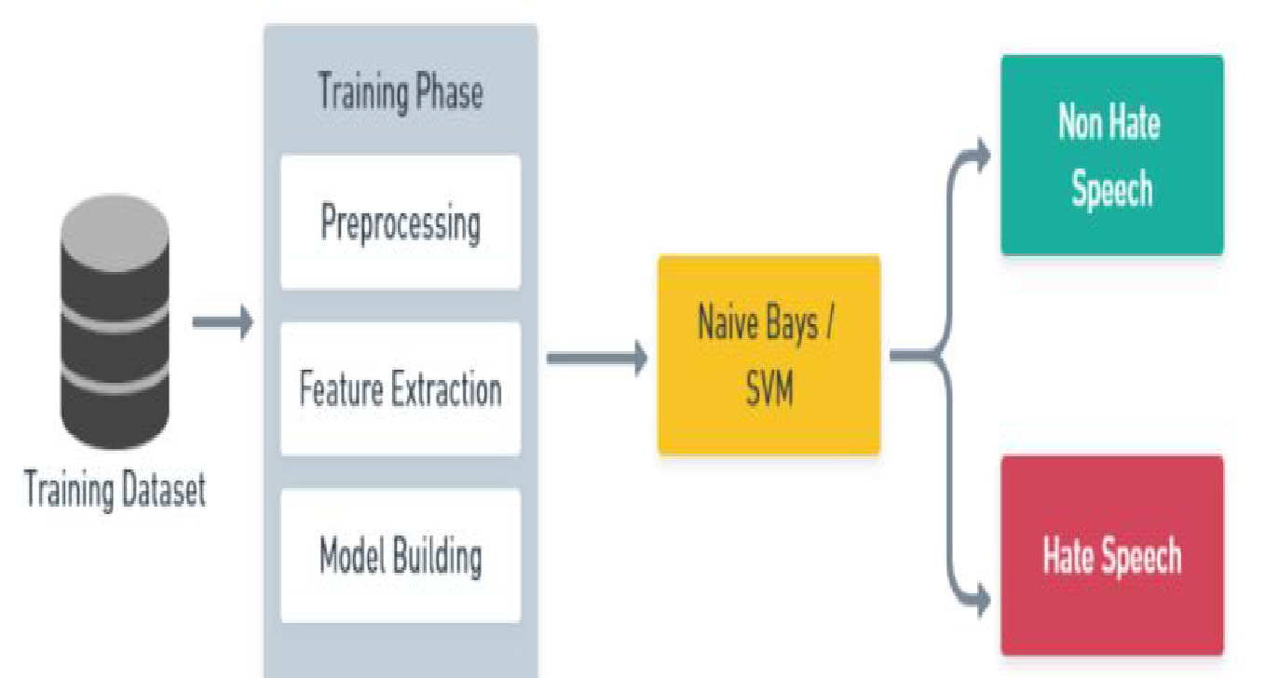
Proposed Methodology
Machine learning is a type of artificial intelligence used for learning from data and finding patterns.
Machine learning algorithms can detect hate speech in text data.
Automated hate speech detection is essential for combating hate speech in social media.

Slide 9
Proposed Methodology
Shallow Methods:
Shallow hate speech detectors use traditional word representation algorithms (e.g., TF-IDF and ngrams).
Classification algorithms such as SVM, naive Bayes, logistic regression, random forest, and gradient boosting decision trees are applied.
Deep Learning Methods:
Deep hate speech detectors use deep neural network-based models.
Popular deep neural network designs include CNN, LSTM, and bi-directional LSTM.
Word-Embeddings Based Methods:
Word embeddings represent words as distributed vectorized representations.
Word2Vec, Glove, and FastText are common word embedding methods.
LSTM, Bi-LSTM, and CNN can be combined with word embeddings for hate speech detection.
Transformer-Based Methods:
Modern transformers like Small BERT, BERT, ELECTRA, and AlBERT are used in deep learning models.
These models can be combined with LSTM, Bi-LSTM, or CNN for hate speech detection.

Slide 10
Conslusion
Machine learning is integral in detecting hate speech, especially on social media. Two key methods are used: shallow approaches with traditional word representation and deep learning with neural networks. Shallow methods utilize classifiers like SVM and logistic regression, while deep learning employs techniques like word embeddings or transformers, integrating CNN, LSTM, or bi-LSTM architectures. Deep learning can be divided into word-embeddings based (using vectors for words) and transformer-based (leveraging modern models like BERT). These methods collectively aid in identifying and addressing hate speech, promoting safer online spaces.

Slide 11
Future Scope
Advanced machine learning and NLP techniques for enhanced accuracy.
Multilingual and cross-platform detection capabilities.
Improved understanding of contextual language usage.
Real-time monitoring and quicker response to hate speech.
User-centric approaches for educating and promoting positive interactions.
Addressing ethical and privacy concerns.
Compliance with evolving regulations and guidelines.
Collaboration with online communities for platform-specific insights.

Slide 12

Future Scope
9.Emphasis on explainable models for transparency.
10.Ongoing research and development to adapt to evolving tactics in hate speech.

Slide 13
References
[1] Fortuna, P., Nunes, S., & Rodrigues, P. (2018). A survey on automatic detection of hate speech in text. ACM Computing Surveys (CSUR), 51(4), 1-30.
[2] Bhatia, P., Jain, R., & Kar, S. (2020). Automatic detection of hate speech: A survey. Journal of Ambient Intelligence and Humanized Computing, 11(9), 3837-3855.
[3] Thakur, V., & Jain, A. (2020). A review on hate speech detection using machine learning techniques. Journal of Ambient Intelligence and Humanized Computing, 11(11), 5021-5034.
[4] Schmidt, A., Wiegand, M., & Fox, C. (2017). A survey on hate speech detection using natural language processing. In Proceedings of the Fifth International Workshop on Natural Language Processing for Social Media (pp. 1-10).
[5] Kwok, I., & Wang, Y. (2013). Locate the hate: Detecting tweets against blacks. In Proceedings of the 2013 Conference on Empirical Methods in Natural Language Processing (pp. 1781-1791).

Slide 14
THANK YOU

